Slide 1



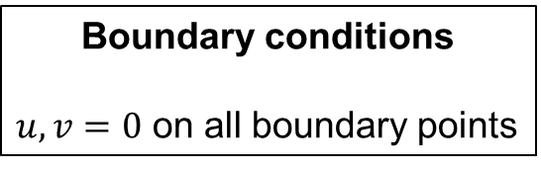
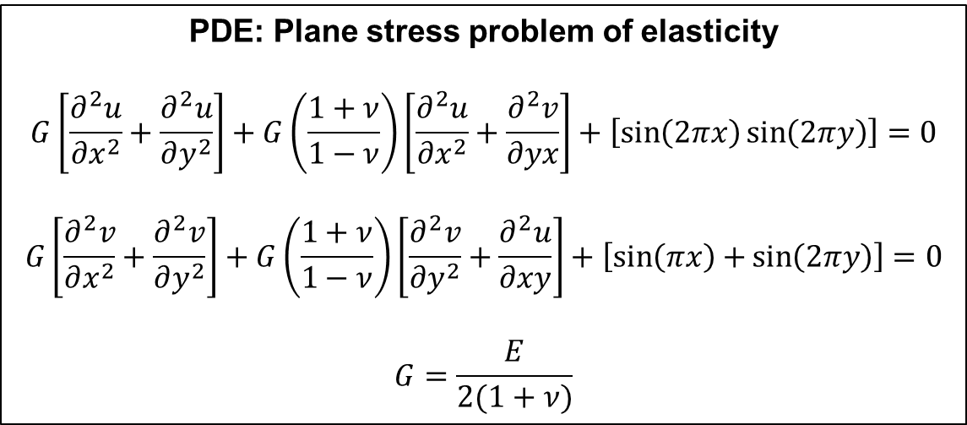

2D PINN for Boundary Value Problem of Linear Elasticity
Thin plate fixed at the boundary with periodic in-plane loading in the interior.
Classis case of plane stress boundary value problem of linear elasticity
PDE: Plane stress problem of elasticity
$$G\left[\frac{∂^{2}u}{∂x^{2}}+\frac{∂^{2}u}{∂y^{2}}\right]+G\left(\frac{1+ν}{1−ν}\right)\left[\frac{∂^{2}u}{∂x^{2}}+\frac{∂^{2}v}{∂yx}\right]+\left[\sin\left(2πx\right)\sin\left(2πy\right)\right]=0$$
$$G\left[\frac{∂^{2}v}{∂x^{2}}+\frac{∂^{2}v}{∂y^{2}}\right]+G\left(\frac{1+ν}{1−ν}\right)\left[\frac{∂^{2}v}{∂y^{2}}+\frac{∂^{2}u}{∂xy}\right]+\left[\sin\left(πx\right)+\sin\left(2πy\right)\right]=0$$
$$G=\frac{E}{2(1+ν)}$$
$$E=1$$
$$ν=0.3$$
$$1$$
Body force ($f_{y}$)
Boundary conditions
$u,v=0$ on all boundary points
$$1$$

Slide 2
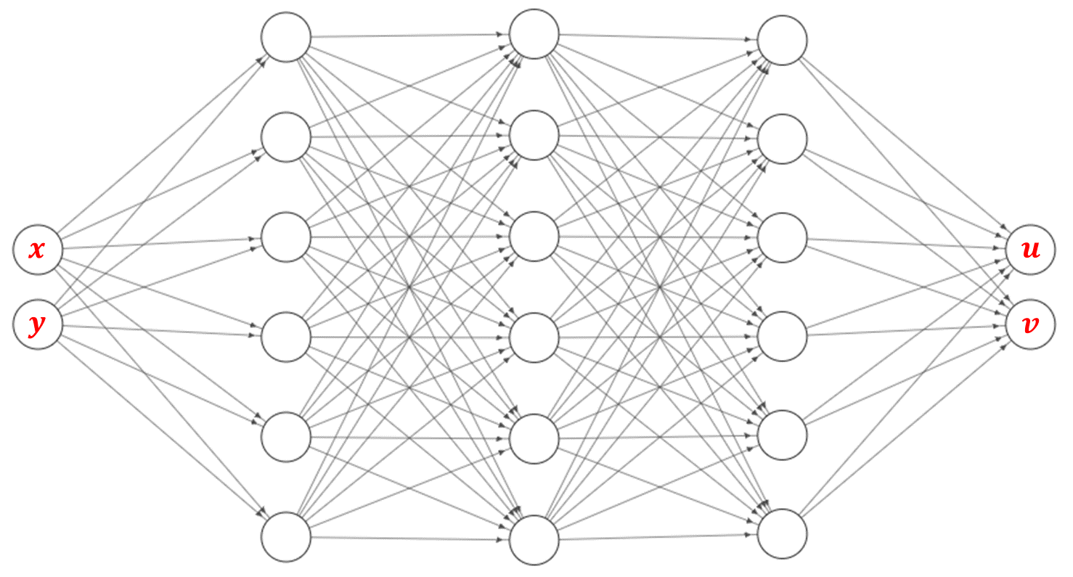
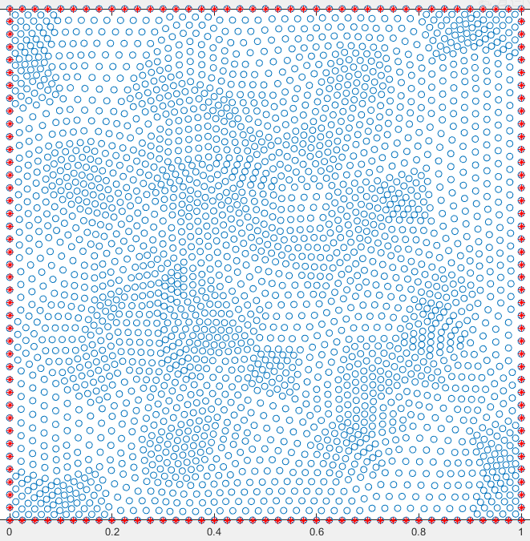
No. of hidden layers | 5
No. of neurons in each layer | 30
Activation function | Tanh
Optimizer | Adam
Learning rate | 0.0005
No. of epochs | 2000
Given:
Interior collocation points: ‘interior_points.mat’
Boundary points: ‘boundary_points.mat’
Total loss = PDE loss + BC loss
PDE loss = PDE₁ loss + PDE₂ loss
BC loss = BC_{u} loss + BC_{v} loss

Slide 3
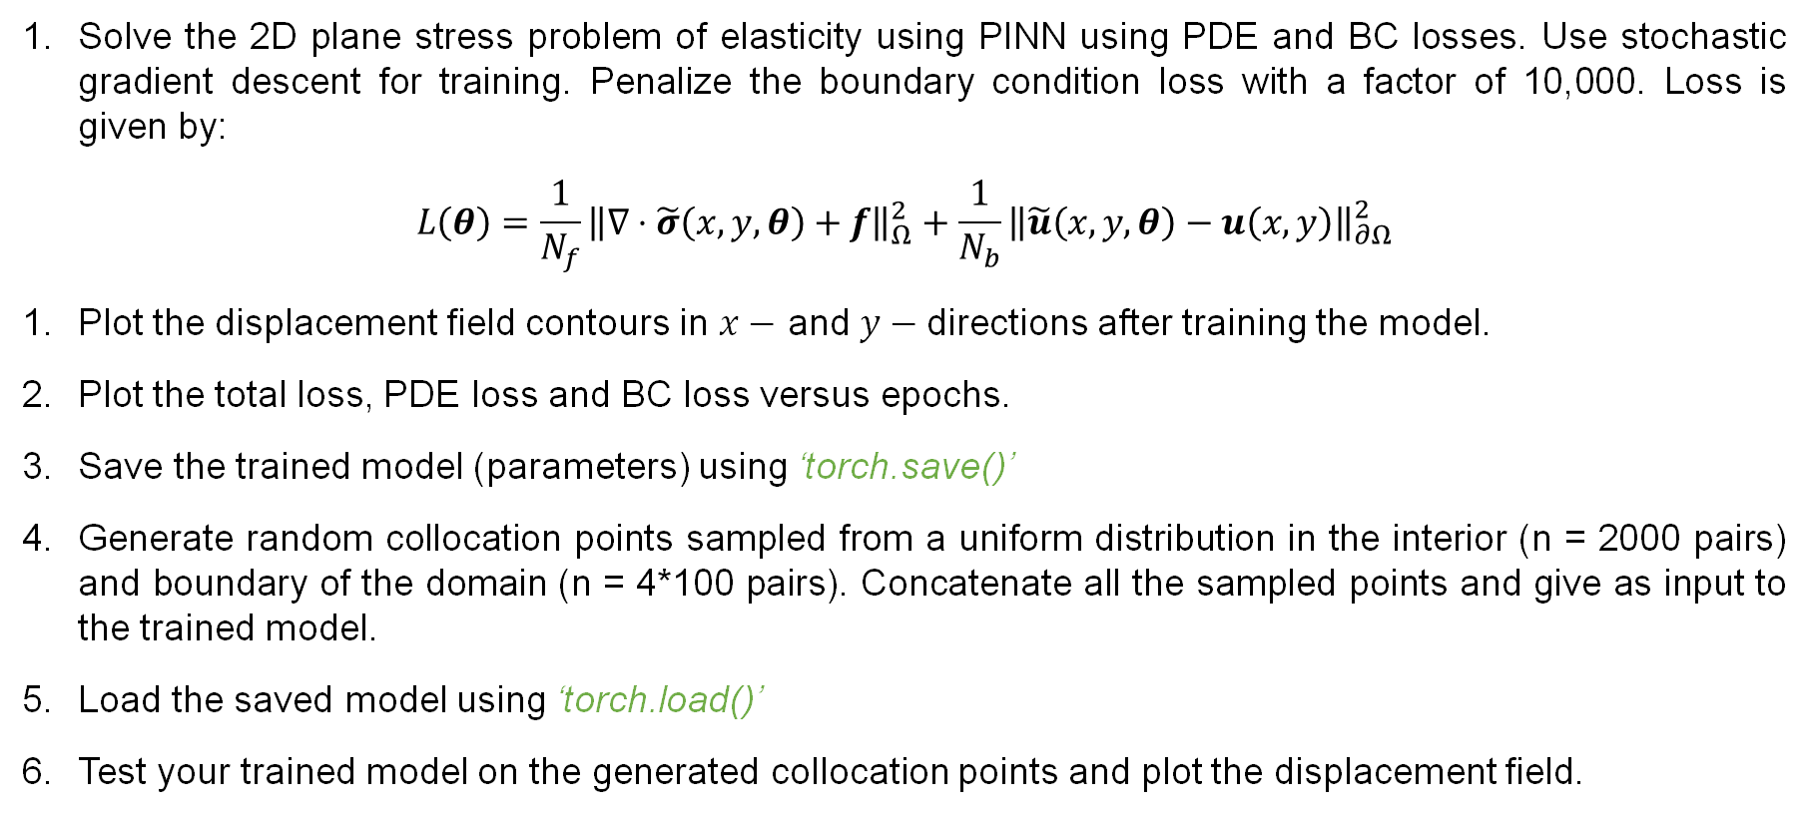
Assignment questions
Solve the 2D plane stress problem of elasticity using PINN using PDE and BC losses. Use stochastic gradient descent for training. Penalize the boundary condition loss with a factor of 10,000. Loss is given by:
$$L\left(θ\right)=\frac{1}{N_{f}}{\left\|∇⋅\tilde{σ}\left(x,y,θ\right)+f\right\|}_{Ω}^{2}+\frac{1}{N_{b}}{\left\|\tilde{u}\left(x,y,θ\right)−u\left(x,y\right)\right\|}_{∂Ω}^{2}$$
Plot the displacement field contours in $x−$ and $y−$directions after training the model.
Plot the total loss, PDE loss and BC loss versus epochs.
Save the trained model (parameters) using ‘torch.save()’
Generate random collocation points sampled from a uniform distribution in the interior (n = 2000 pairs) and boundary of the domain (n = 4*100 pairs). Concatenate all the sampled points and give as input to the trained model.
Load the saved model using ‘torch.load()’
Test your trained model on the generated collocation points and plot the displacement field.

Slide 4
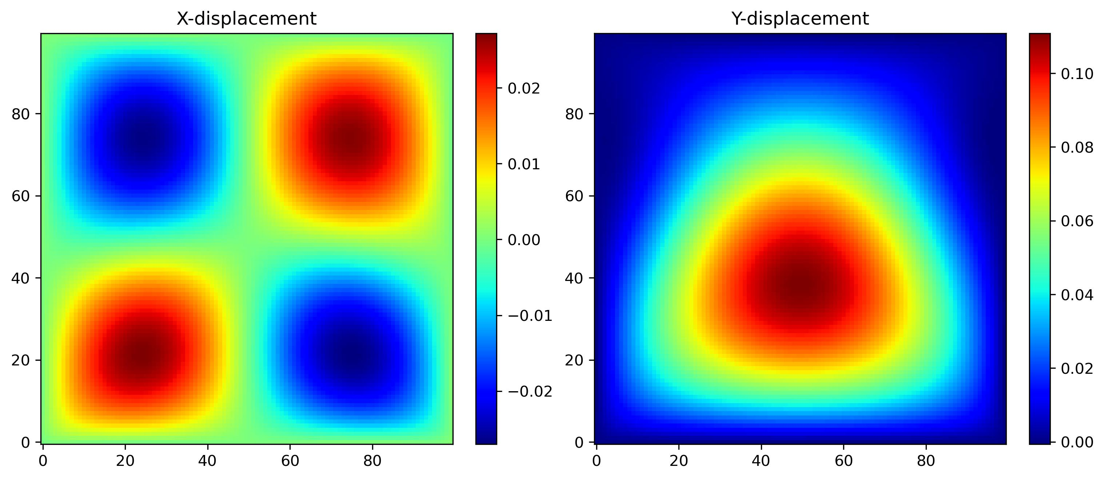
PINN based solution

